Slide 1


Moving More in Sheffield
How Sheffield supported people with long-term health conditions to be physically active during the pandemic

Slide 2


INTRO
The National Centre for Sport and Exercise Medicine - Sheffield was awarded the funding to carry out the We Are Undefeatable project.
Move More is the physical activity strategy for Sheffield and the network to support and connect partners across the city.
The work we carried out included a range of stakeholders and went through five phases.
Notes:
Introduce myself and role in the project.
5 Phases to this work due to Covid and original aims being put on hold. . I will walk you through them today and the learning gathered.

Slide 3

OUR PLACE
The amount of people living with one or more long term health condition (LTHC), in Sheffield is higher than the national average, the figure is estimated to be over 100,000.
Approximately 25% of people in the city are inactive, doing less than thirty minutes of any physical activity per week. Sheffield also has very stark inequalities, with a 20 year difference in life expectancy between the most disadvantaged and most affluent parts of the city.
We recognised that people with LTCs have many interactions with primary care teams and that the reconfiguration of services into Primary Care Networks (PCNs) provided an opportunity to embed PA into systems, processes and structures at their inception.

Slide 4
AIMS AND OBJECTIVES (Initial)
To engage with and work closely with a range of stakeholders within a test-bed PCN.
To understand baseline attitudes and practices related to PA.
To explore opportunities and identify priorities where change is warranted and feasible.
To deliver co-produced solutions that have potential to be sustained as 'business as usual' by PCNs.
To evaluate the project and identify key learning.
To actively share this learning via networks to enable other PCNs to adapt and implement.
Notes:
Steering Group to support – VCS, Move More, PCN, SCC, Coproduction expert

Slide 5
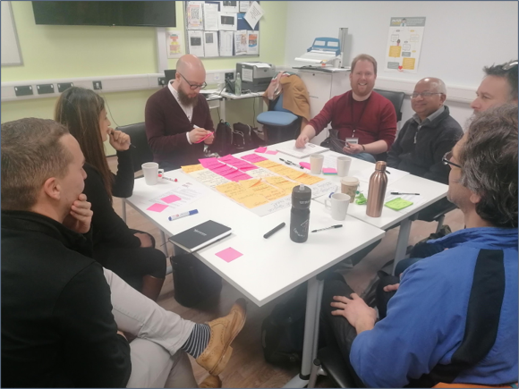
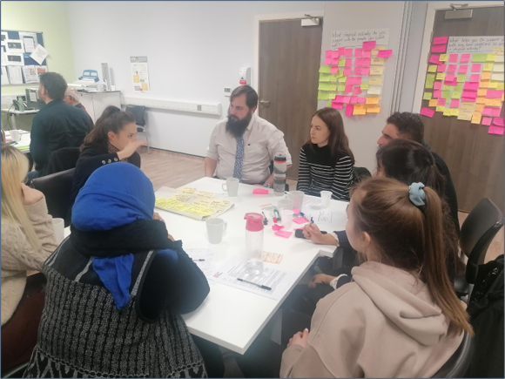
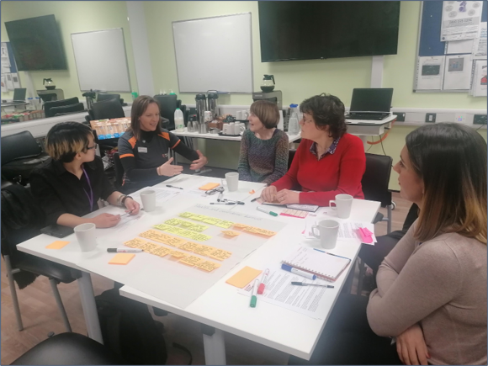
OUR APPROACH – PHASE ONE
We engaged with partners working with the PCN both from within the community and the health sector. We also planned workshops for members of the local community but unfortunately these were cancelled due to Covid.
Notes:
We will be working closely with one test-bed PCN (Heeley Plus in Sheffield) to explore opportunities and create innovative solutions that meet identified needs.
A steering group established that consisted of Primary Care and local VCS partners and was coordinated by Yorkshire Sport Foundation with support from an organisation that specialises in co-production approaches​ (Co:Create)
The aim was to understand baseline attitudes and practices related to Physical Activity and explore opportunities and identify priorities where change is warranted and feasible.
We will then use this insight to deliver co-produced solutions that have the potential to be sustained as 'business as usual' by PCNs. ​
Working with local partners and people living with LTHC we planned to co-design a shortlist of ideas for practical actions that would support them into physical activity (PA)​ and establish what helps and what makes it harder for people with LTHC to be active

Slide 6
LEARNING - PHASE ONE
Health Care Professionals have limited time which impacts availability to engage in the process/ exploration of the issues.
Health Care Professionals care and get it – how do we support them?
Existing and trusted relationships are essential
People and organisations want “stuff” – how do we change these attitudes and culture to less here and now and the benefit of investing into whole systems thinking?
Notes:
Existing relationships - helped us to get the VCS anchor organisation involved.
We relied on those VCS organisations to engage the smaller/local VCS organisations – Benefit of existing trusted relationships
Starting from scratch is hard, existing relationships are key.

Slide 7

AIMS AND OBJECTIVES - COVID
Notes:
In March 2020 the COVID-19 situation hindered the original project aims, making it impossible to deliver as it involved face-to-face contact with people with LTCs who were shielded, and healthcare professionals who were at full capacity responding to the growing crisis.
Following discussion with the project steering group, key local stakeholders and Sport England we took the decision to cease work on the original project and to direct our efforts to support people to stay active during the period of lockdown.

Slide 8
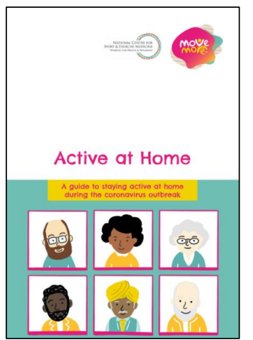
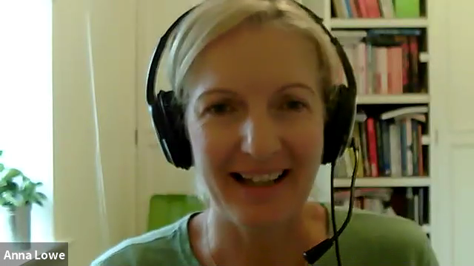
OUR APPROACH – PHASE TWO
A rapid and collaborative effort to support people in Sheffield, particularly those with health conditions, to stay active during lockdown.
Notes:
Dr Anna Lowe – NCSEM Programme Manager lead on the development of the Active at Home booklet and will talk us through it during this short video.

Slide 9
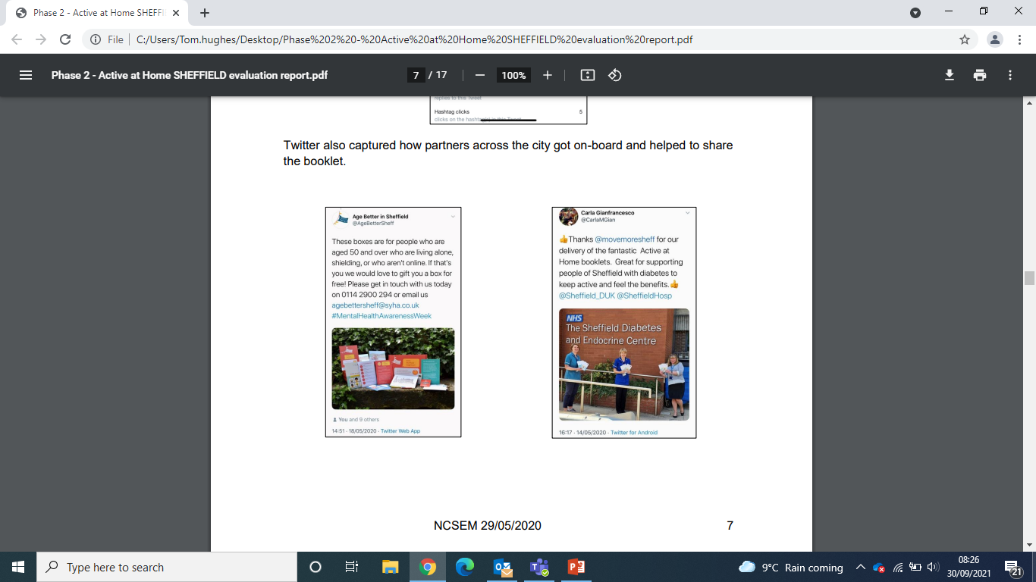
LEARNING– PHASE TWO
There was a real sense of purpose in the collaboration to create this resource. New relationships have been developed and existing relationships have been renewed and strengthened.
Ensuring that hard copies were readily available and circulated via key partners was essential to reaching our target audience (65+)
Using social media to promote this opportunity to the local organisations (gatekeepers to the audience) to generate a distribution list was also important
Notes:
- Full evaluation report can be shared

Slide 10
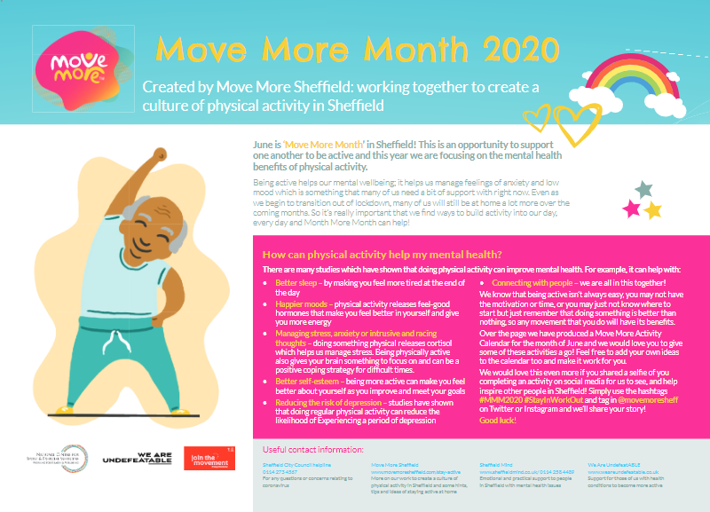
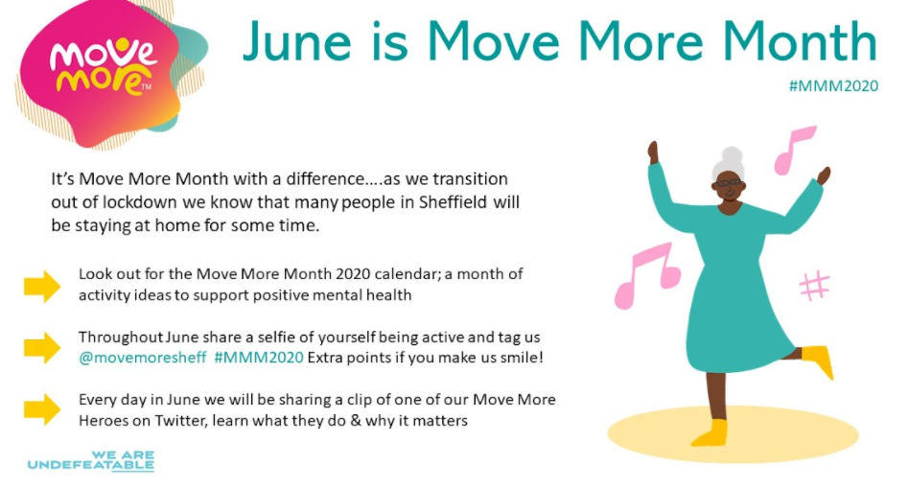
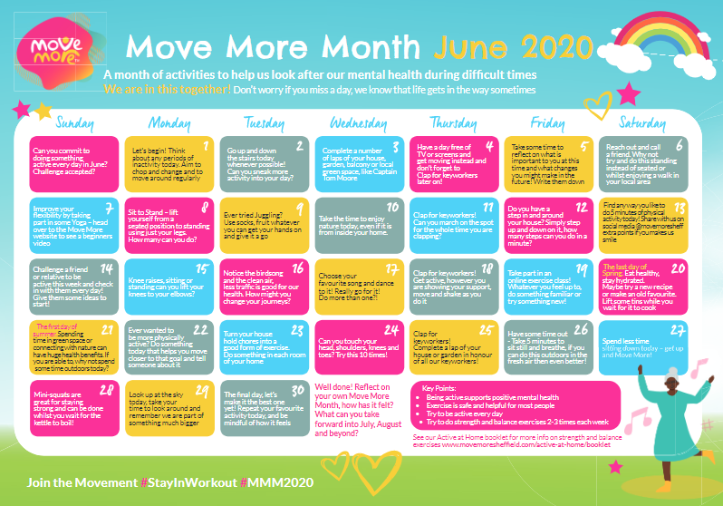
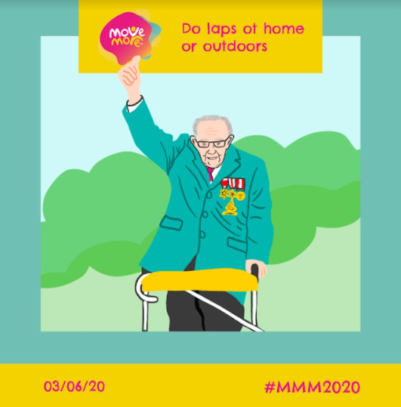
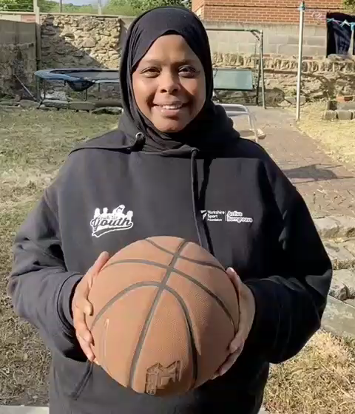
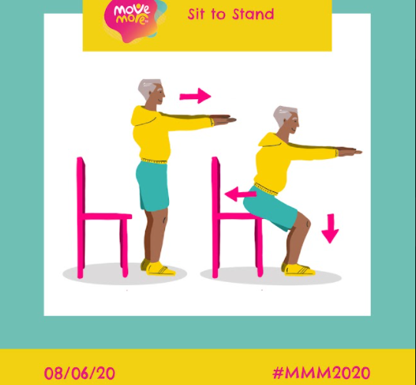
OUR APPROACH – PHASE THREE
Notes:
June is historically Move More Month in Sheffield. But how do you deliver in lockdown?
Following the success of the Active at Home booklet, we created and circulated a June calendar with ideas, suggestions and activities focusing on mental wellbeing and the role that physical activity can play in this.
This was circulated to 50,000 homes across 10 of the priority wards in Sheffield, reaching a whole range of audiences and communities.
Alongside the calendar we also ran a social media campaign.
We invited local people, influencers and people involved in the Move More network to share a short video of what inspires them to get active and stay active.
These were shared every day via the @movemoresheff social channels

Slide 11
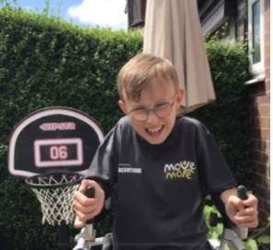
LEARNING– PHASE THREE
Social media helped amplify our message during the month of June and reached a more professional/organisational audience than the calendars, which were targeting end users.
The most popular videos came from local community advocates, people who were representative of their community.
Relate to what is current e.g. Captain Tom Moore, Captain Tobias
Notes:
Captain Tobias – inspired by the fundraising efforts of Captain Tom Moore. Tobias has cerebral palsy & autism has set himself a series of challenges including 2 marathons during lockdown raising money for local charities.

Slide 12







OUR APPROACH – PHASE FOUR
Create a Physical Activity Health Alliance for the City…
Notes:
We (both locally and SE) were keen to pick up where we had left off with our original plans now lockdown measures were starting to ease. One of the gaps we identified was a network for the health charities in the city.
A network of partners that can come together and discuss Long Term Health Conditions and Physical Activity. Utilised coproduction experts to deliver online creative workshops.
We wanted to bring the local Richmond Group of partners around the “table” to discuss what we could do locally to work together and create change for people with Long Term Health Conditions in Sheffield.
We wanted to:
1) Find out if there is an appetite for a Physical Activity Health Alliance (a network of health charities).
2) Begin to build relationships between organisations.
3) Gather initial thoughts on how the network might look.
We hosted 2 x 2.5 hour workshops designed and facilitated by Co:Create in conjunction with Yorkshire Sport using Zoom.
The 15 local health charities in Sheffield that are part of the Richmond Group of Charities were invited. Each workshop had seven attendees, with representatives from the following organisations:

Slide 13
LEARNING – PHASE FOUR
Not every charity was aware of the WAU campaign.
Not every charity has the same capacity/ resource, some have a local officer and others have regional representatives.
Charities were keen to have more “stuff” happening. More sessions specific to their group/condition to sign post to.
The charities had adapted relatively well to moving sessions online as a result of COVID. However they wanted more content to signpost to online. Also a recognition that digital exclusion is an issue among some service users.
The project has enabled conversation and discussions with a network of partners that didn’t exist previously.

Slide 14
OUR APPROACH – PHASE FIVE
With the support of Sport England we were able to revisit our original plans:
The aim of the project was to support these evolving primary care networks to create a meaningful and sustainable approach to physical activity that will ultimately increase the activity levels of local people living with long term conditions.
Notes:
The extension granted by Sport England was to enable us to revisit the original phase one approach of working with a local Primary Care Network.
Community organisations were enthusiastic about revisiting the project and keen to be Involved.
We undertook initial meetings with the clinical director and colleagues to get a perspective of the current healthcare climate however continued COVID impact meant that capacity to engage was limited.
Interviews with local people with long-term conditions and partners have identified specific gaps and barriers to support people into physical activity in the Heeley Plus area.

Slide 15
ACTION – PHASE FIVE
The recruitment of a part time officer who's role will be to:
  Re-engage the (currently underserved) local community in Gleadless in physical activity. Employment of a part-time community worker who specialises in physical activity to run a series of workshops, tasters to increase confidence and interest in physical activity.
  Provide digital inclusion training to people with long-term conditions with support to develop digital “guides” to their condition. The co-produced guides will provide information for others on how to live well and manage activity with a long-term condition, signpost to further resources and highlight opportunities for peer support.
Notes:
The proposed initiatives have the full support of Heeley Plus PCN and our intended approach complements local priorities regarding long-term conditions, inequalities and a growing partnerships across the area where we have identified Heeley Development Trust (HDT) to lead the implementation of two initiatives:

Slide 16
LEARNING – WIDER OUTCOMES
Dedicated funding to support this work enabled the city to work in areas, have conversations and connect with organisations it didn’t previously.
Additionally the WAU project may not see immediate impact on activity levels with people living with LTHC this project has created new connections and has led to further conversations that have connected the ‘system’ to itself better which in turn will lead to future collaboration.
A recognition that our VCF organisations are better placed to deliver these projects. The ability to work with them to co-design projects/interventions is key and again strengthens local trust.

Slide 17
NEXT STEPS
Ongoing support to two to implement two local projects locally:
  Heeley Development Trust
Recruitment of a part-time community worker who specialises in physical activity to run a series of workshops, tasters to increase confidence and interest in physical activity in a focused community.
Providing digital inclusion training to people with long-term conditions and supporting them to develop digital “guides” to their condition – including managing their condition and staying physically active.
  Age UK Sheffield
    Tablet lending scheme – devices will be pre loaded with physical activity sessions and introduced to customers via the Independent Living Coordinators at Age UK Sheffield who make regular visits to people living with LTHC

Slide 18
NEXT STEPS cont.
Share the physical activity digital videos and guides via the Move More website and local networks
Continue to share learning gathered through the projects with Sport England, partners in Sheffield and other WAU projects.
Continue to connect in partners, conversations and opportunities locally with these and existing projects.

Slide 19
OUR RECOMMENDATIONS
Build on what’s strong and go where the energy is.
Utilise expertise which already exists in the system.
Bring people on the journey with you; learn, design and deliver together. Coproduce your approaches and do this from the very start.
Learn and adapt along the way.
Be open to new ideas and willing to give them a go – often this is where the greatest learning is. Take a risk!
Take time to develop local relationships with partners and create robust networks across the sector.

Slide 20
www.movemoresheffield.com
@movemoresheff

